Slide 1
Happy Run
Student Name: Joseph Roper
Say what retro gaming is

Slide 2
Introduction
In this PowerPoint presentation I will provide evidence of how I have added sound to my video game made on construct 2.
Ambient sound in a video game is the background sound, such as the music.
Directional sound in video games are things like speech from a character or the sound effect added to a characters action like a jump.

Slide 3
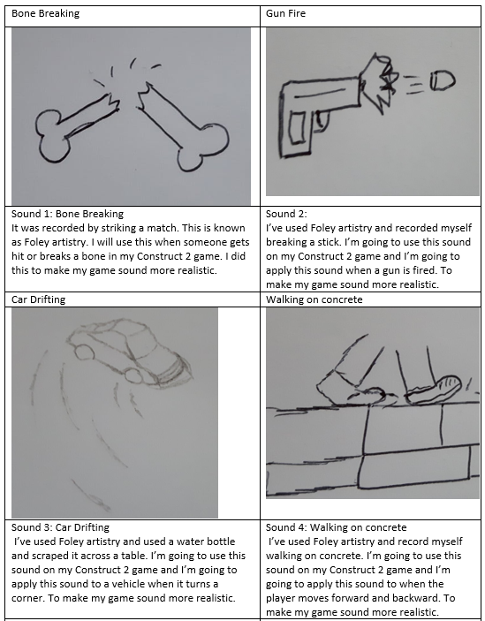
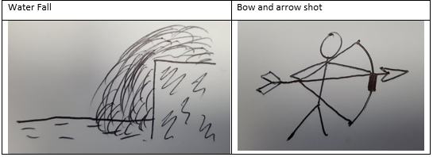
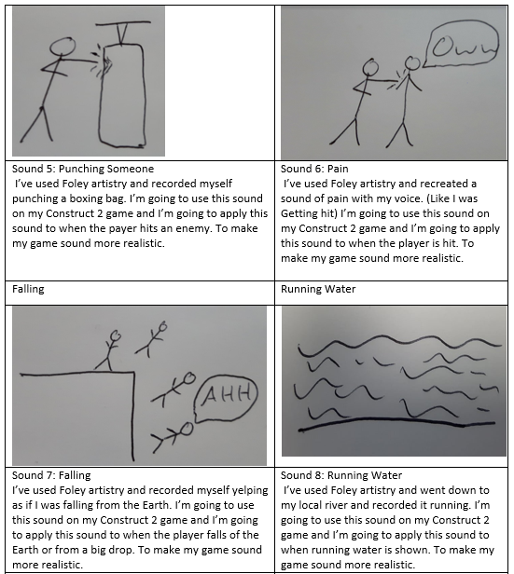
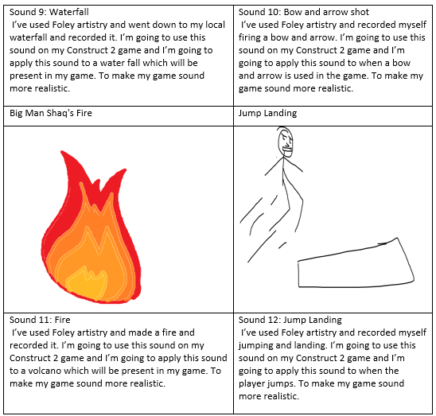
My Sound Library

Slide 4
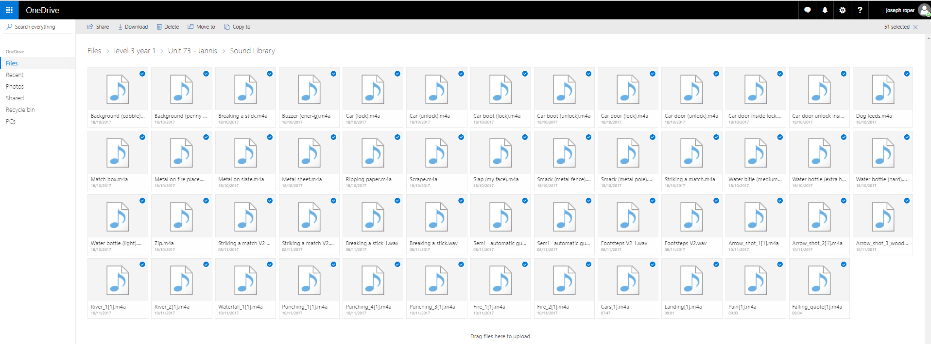
How to find these samples easily and quickly in the future
I have saved all of these sound files in my own personal OneDrive meaning I can access them from anywhere in the world as long as I am connected to the internet.

Slide 5
How I have created my sound samples?
I created most of these sounds using Foley artistry to copy what the sound would sound like in real life for example to get the sound effect of punching someone I recorded myself punching or kicking a boxing bag to get the thud sound that you hear in movies and games. Another way to create sound other than recording a sound yourself is to use the website https://www.bfxr.net/ .

Slide 6
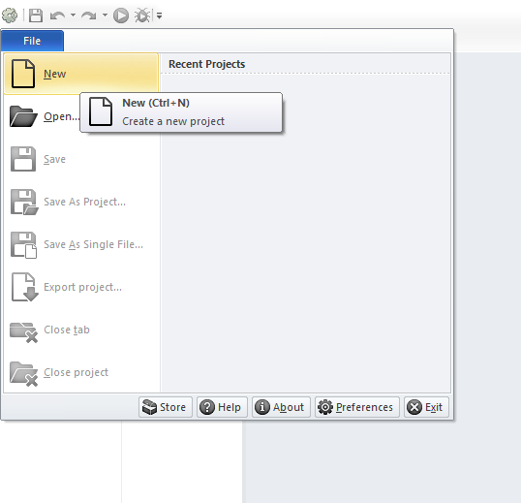
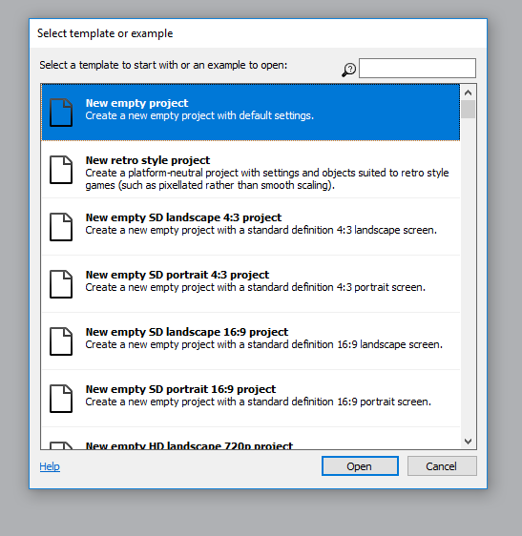
How to import and apply a sound sample onto my video game by using Construct 2
Step 1: Open Construct 2 and create a new project by going to file then New or pressing Ctrl + N then select new empty project.

Slide 7
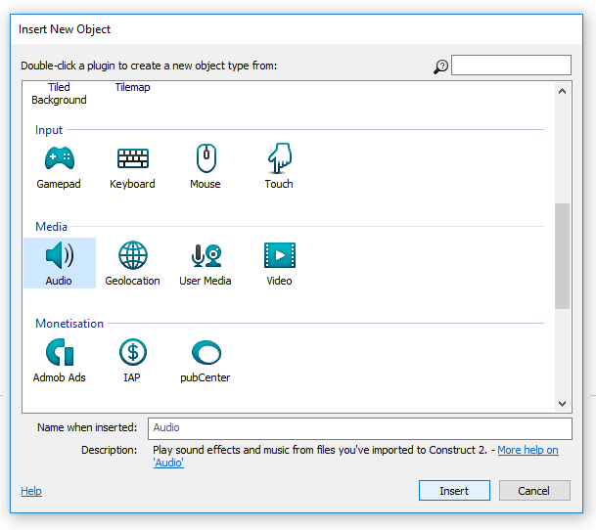
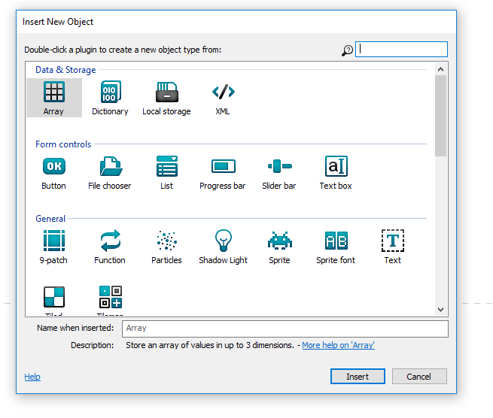
Step 2
Double click the white background then scroll down and select audio then press insert.

Slide 8
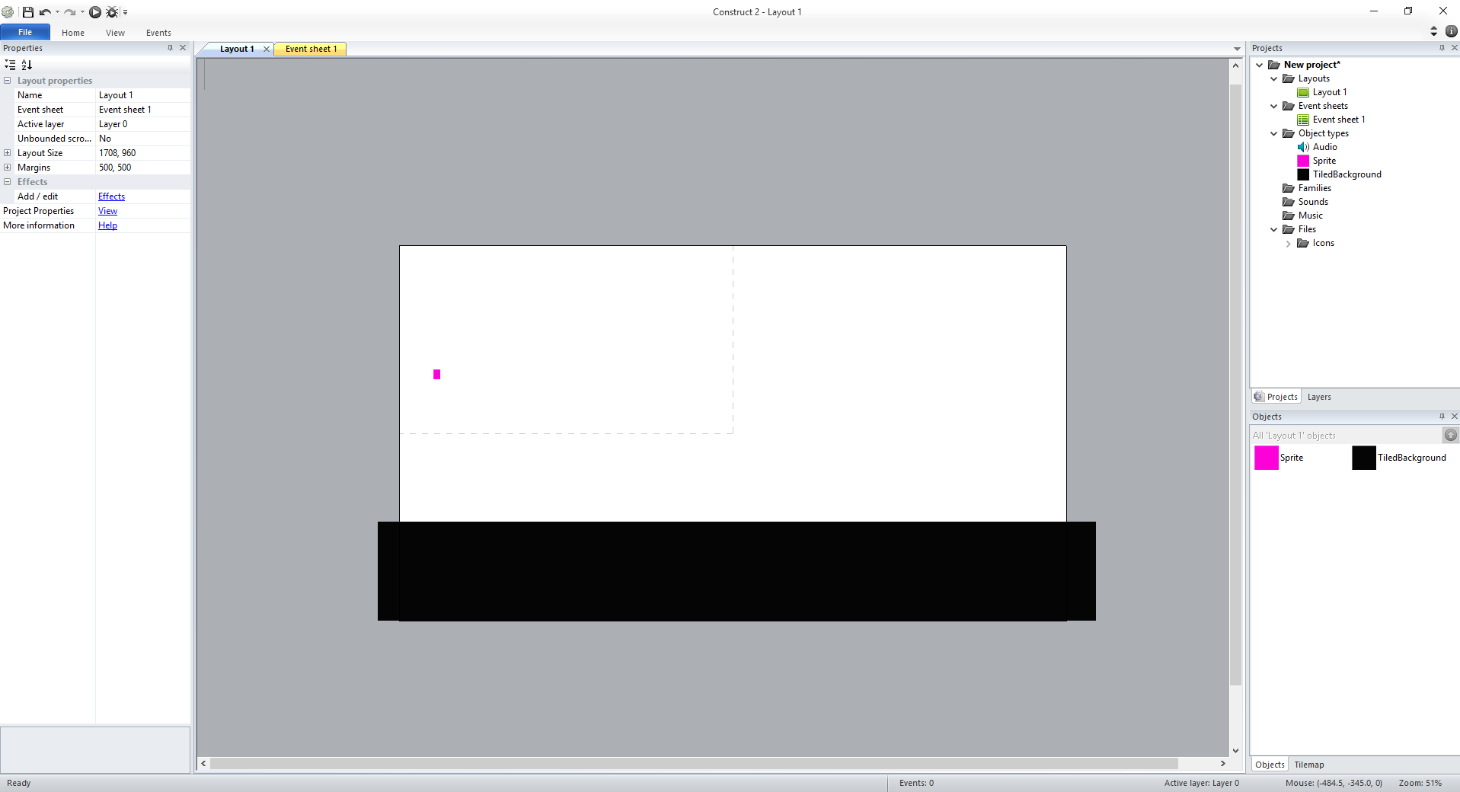
Step 3: Make a sprite and floor

Slide 9
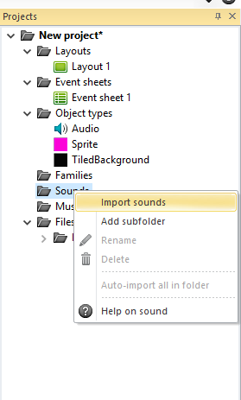
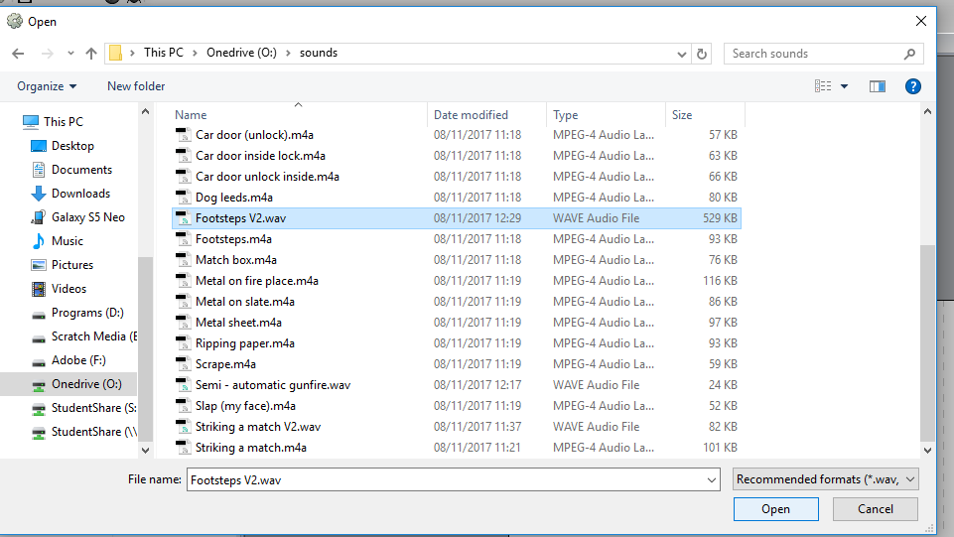
Step 4: Import a sound
Go to the top right of your screen in Construct 2 and click on the Sounds folder then right click it and press import sounds. Then a pop up will display then go to where your sounds are and select the one you want I am going to chose a walking sound. The sound has to be a .wav file.

Slide 10
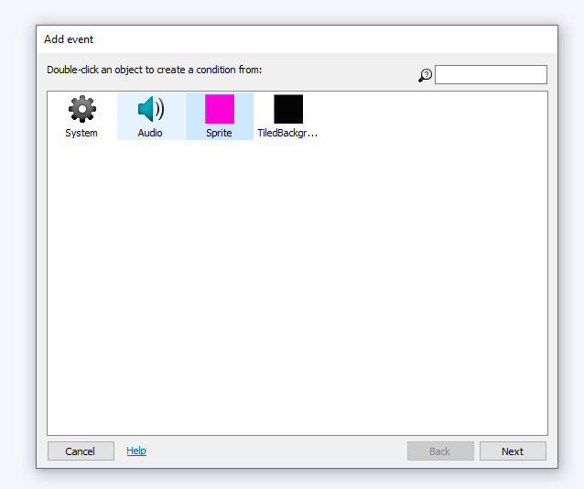
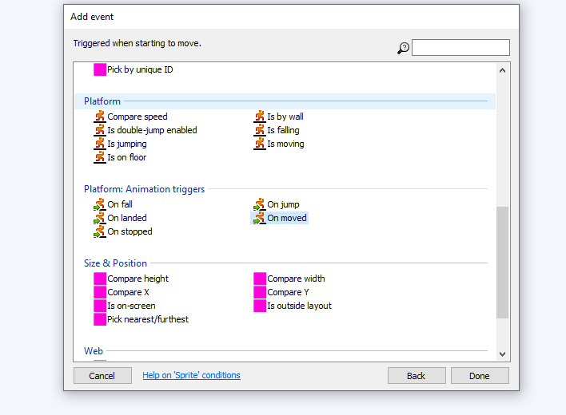
Step 5: Adding a sound
Go to the event sheet at the top of your screen then press add event and select your sprite. Then select your action I will choose On Moved

Slide 11
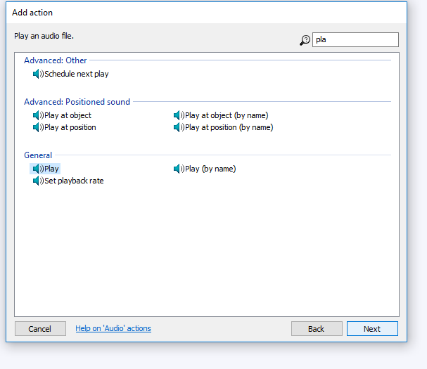
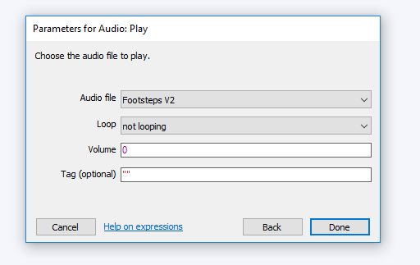
Step 5.5: Adding a sound part 2
Then select audio and press next, then go to the search tab and press play. Then choose your audio file and change the “not looping” to “looping” press done. The sound should then play when you move your sprite.

Slide 12
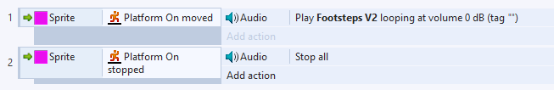
Step 6: Stopping a sound
Now to stop the sound when the player stops moving got to the event sheet. Then add a new event, select your sprite, then go to audio and type stop all in the search bar then select stop all and confirm. Then when you move the sound should play and when you stop the sound should stop.

Slide 13
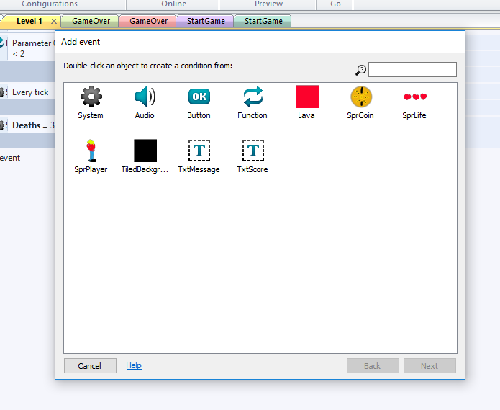
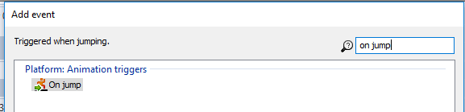

Sound 2: Jumping
The next sound I will use and import in my game will be a jumping sound effect which I will create on https://www.bfxr.net/ .
To add this sound I will to my level 1 event sheet and add a new event. Then I will select the player then type in the top corner of the pop up on jump, then I will select “on jump” and press done. It should then look like this,

Slide 14
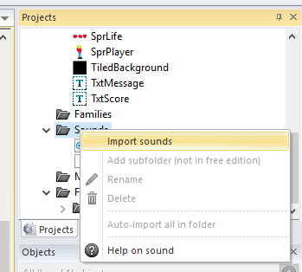
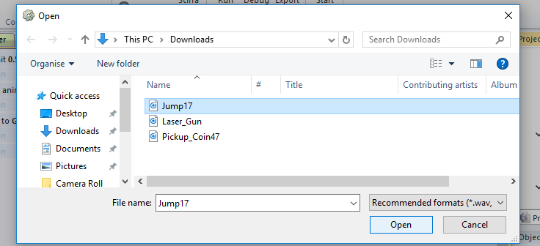
Sound 2: Step 2
Now I will need to import the jumping sound effect, I will do this by going to the projects tab on the right of the screen and right clicking on sounds then pressing import sounds. A pop up will then show so you need to find and select your sound, then press open.

Slide 15
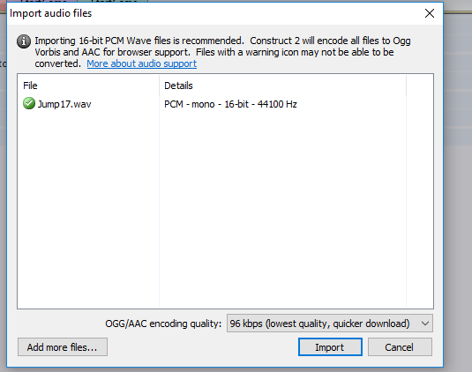
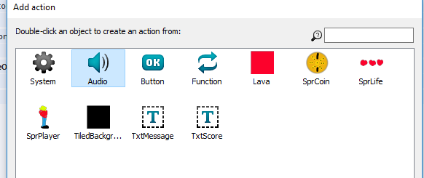
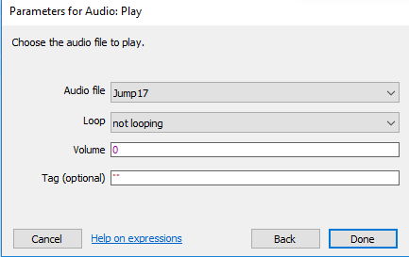
Sound 2: Step 3
Once you have selected the correct sound file another pop up will show with this you need to select import. Now your sound is imported go back to the event sheet and add an action to the previously made event. Select audio then select play. Now select your sound effect and press done. Your sound effect should now play when your character jumps.

Slide 16
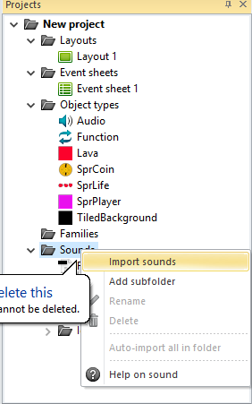
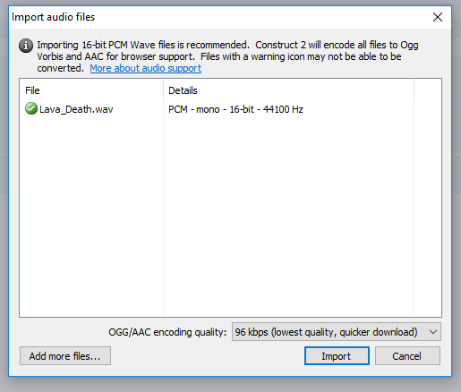
Sound 3: Dying
The next sound I will use and import in my game will be a dying sound effect which I will create on https://www.bfxr.net/ .
Firstly, I will import the death sound to Construct 2 by going to the projects tab, then right clicking the “Sounds” folder and then clicking import sound, choose the sound you want to import and then click it.

Slide 17
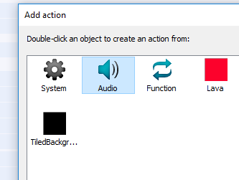
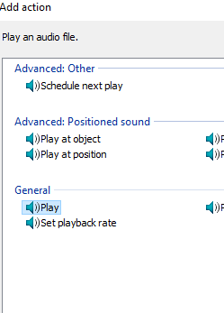
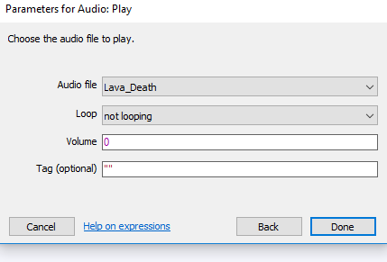

Sound 3: Step 2
To add this sound I will go to my level 1 event sheet and add a new event then I will select the player then search for “on collision with another object” and select that then I will click on the lava which kills my player. Then I will add an action and select audio, then I will press play and select my death sound. Now when my player dies or touches lava the death sound will play.

Slide 18
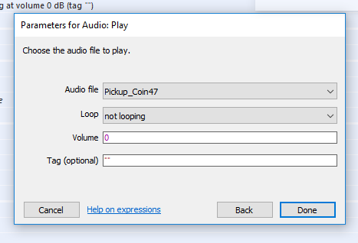
Sound 4: Collecting Coins
The next sound I will use and import in my game will be a sound for collecting coins which I will create on https://www.bfxr.net/ .
To add this sound I will to my level 1 event sheet and add a new event. Then I will select the player then type in the top corner of the popup “on collision”, then I will select “on collision with another object” and then select your collectable such as a coin. Now import your sound effect for this action like previously shown. Then add an action to the event made select audio then find play and select your sound effect and press done.

Slide 19
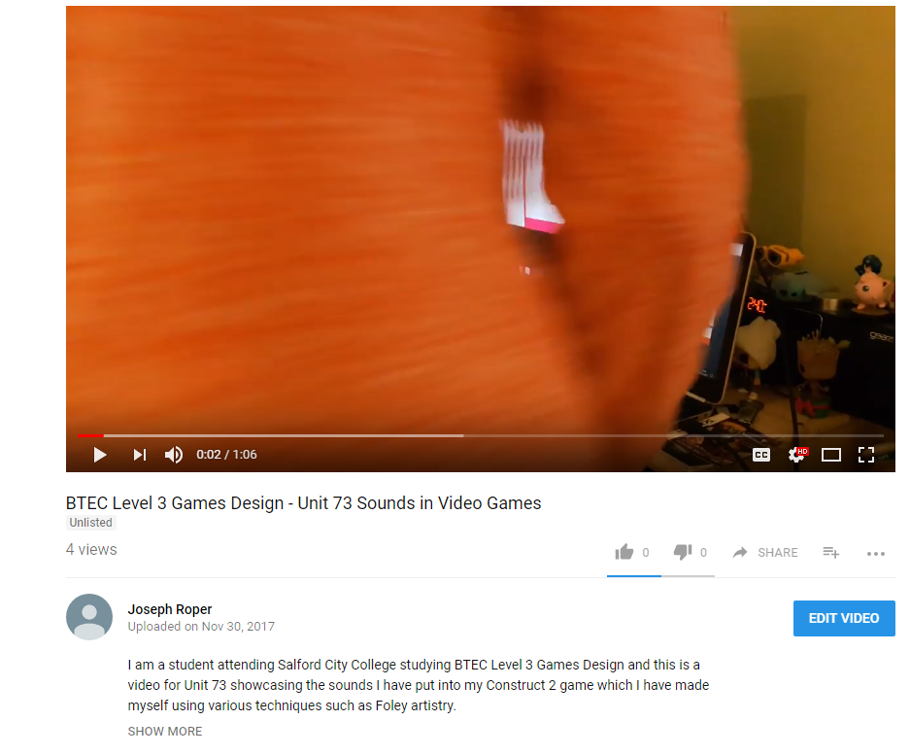
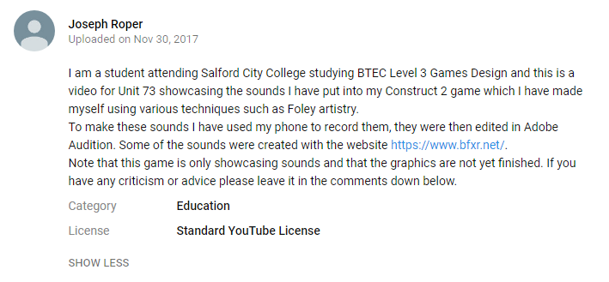
My YouTube Video
I made a YouTube video displaying the sounds I have implemented into my Construct 2 game. https://youtu.be/qzVGPYNfC5E

Slide 20
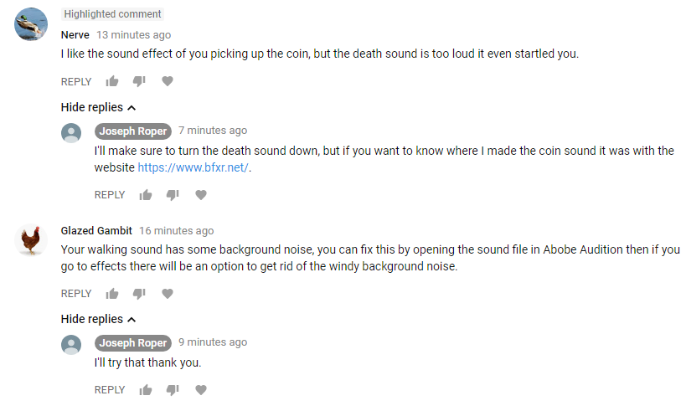
YouTube Feedback and Response
This is the feedback I got with my replies which I intend to do.

